Slide 1
K S Institute of Technology Department of Computer Science and Engineering
Welcome to
2020-21 Odd Semester
5th B
Online Class
On
Course Name : UNIX Programming
Course Code:18CS56

Slide 2
Vision and Mission of Department
Vision:
“To create competent professionals in Computer Science and Engineering with adequate skills to drive the IT industry”
Mission:
M1: Impart sound technical knowledge and quest for continuous learning.
M2: To equip students to furnish Computer Applications for the society through experiential learning and research with professional ethics.
M3: Encourage team work through inter-disciplinary project and evolve as leaders with social concerns.

Slide 3
UNIX PROGRAMMING(18CS56)
Course Learning Outcome: The course will enable the students
Interpret the features of UNIX and basic commands.
• Demonstrate different UNIX files and permissions
• Implement shell programs.
• Explain UNIX process, IPC and signals.

Slide 4


Slide 5
Syllabus: Module 1 - Introduction
Introduction: Unix Components/Architecture. Features of Unix. The UNIX Environment and UNIX Structure, Posix and Single Unix specification. General features of Unix commands/ command structure. Command arguments and options. Basic Unix commands such as echo, printf, ls, who, date, passwd, cal, Combining commands. Meaning of Internal and external commands. The type command: knowing the type of a command and locating it. The root login. Becoming the super user: su command.
Unix files: Naming files. Basic file types/categories. Organization of files. Hidden files. Standard directories. Parent child relationship. The home directory and the HOME variable. Reaching required files- the PATH variable, manipulating the PATH, Relative and absolute pathnames. Directory commands – pwd, cd, mkdir, rmdir commands. The dot (.) and double dots (..) notations to represent present and parent directories and their usage in relative path names. File related commands – cat, mv, rm, cp, wc and od commands.

Slide 6

What is Operating System?
Operating System is a program that acts as an intermediary between user and computer hardware.
Goals of Operating System:
Execute user programs.
Make computer system convenient to use.
Use the computer hardware in efficient manner.

Slide 7
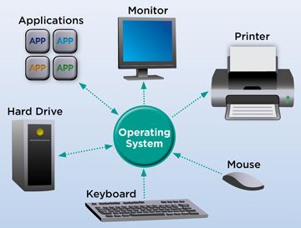
Operating System as Resource Manager.
An operating system (OS) is a resource manager.
It takes the form of a set of software routines that allow users and application programs to access system resources in a safe, efficient and abstract way.

Slide 8
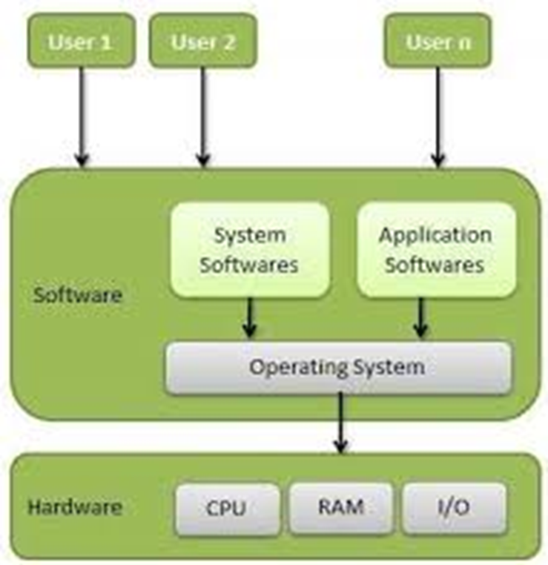
Operating System Structure

Slide 9
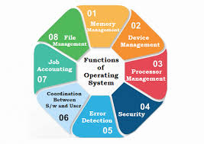
Functions/ Services of Operating System

Slide 10
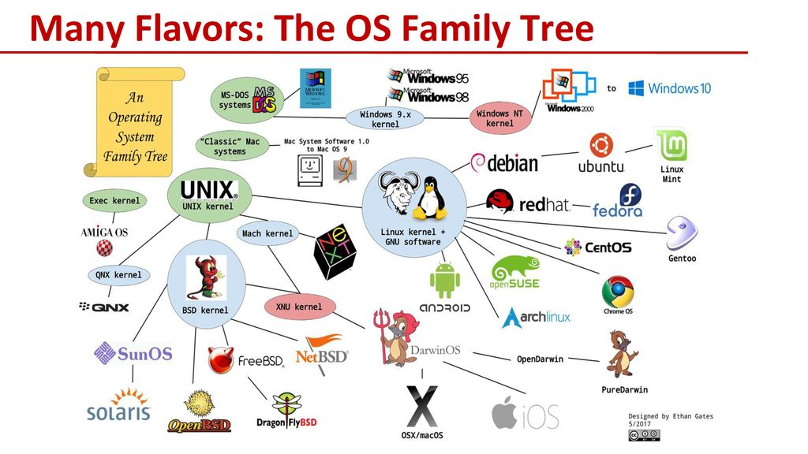

Slide 11


Slide 12
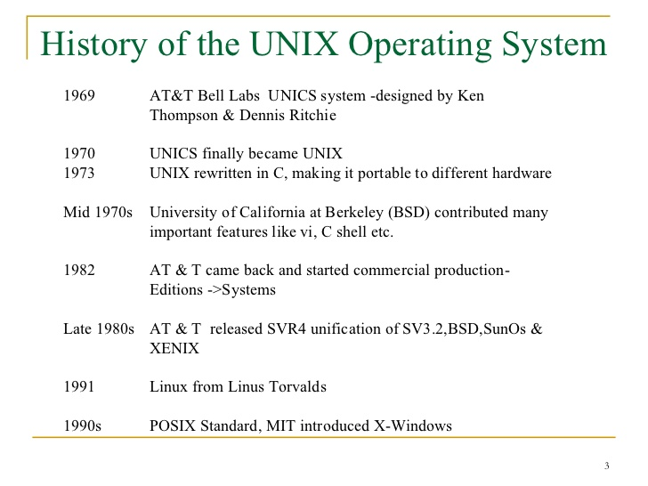
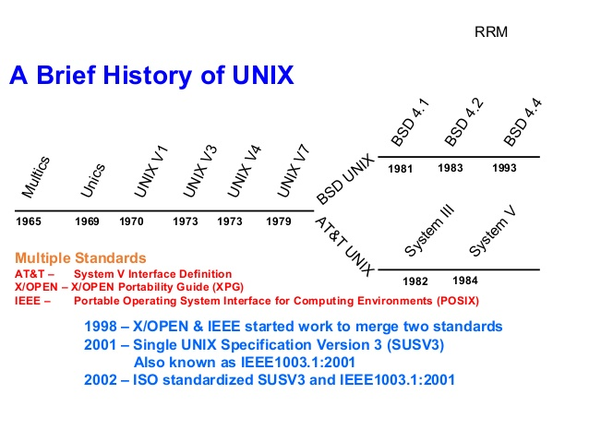

Slide 13
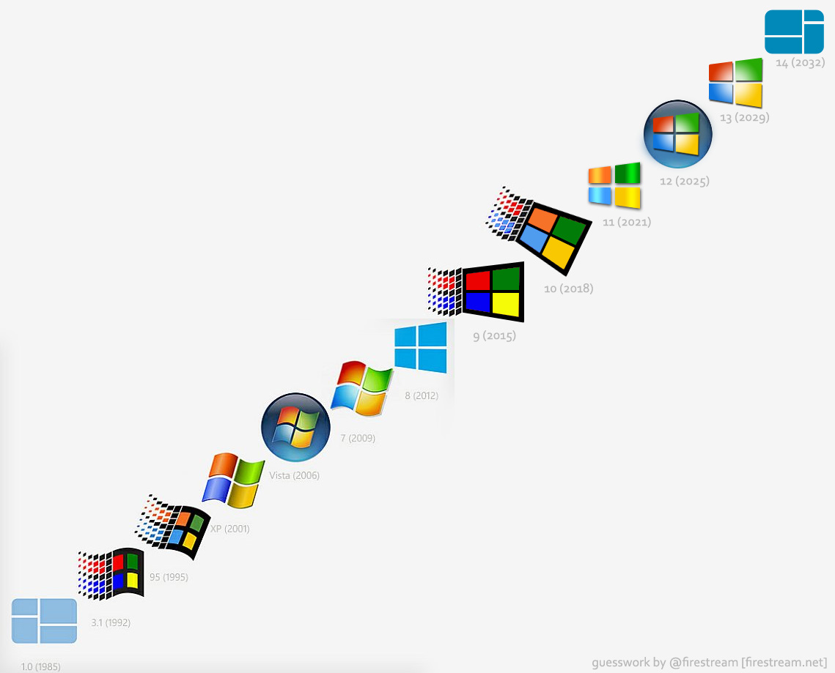
Windows Operating System

Slide 14
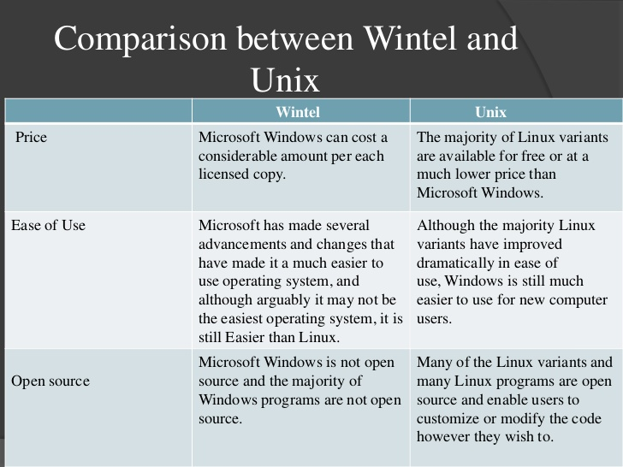

Slide 15
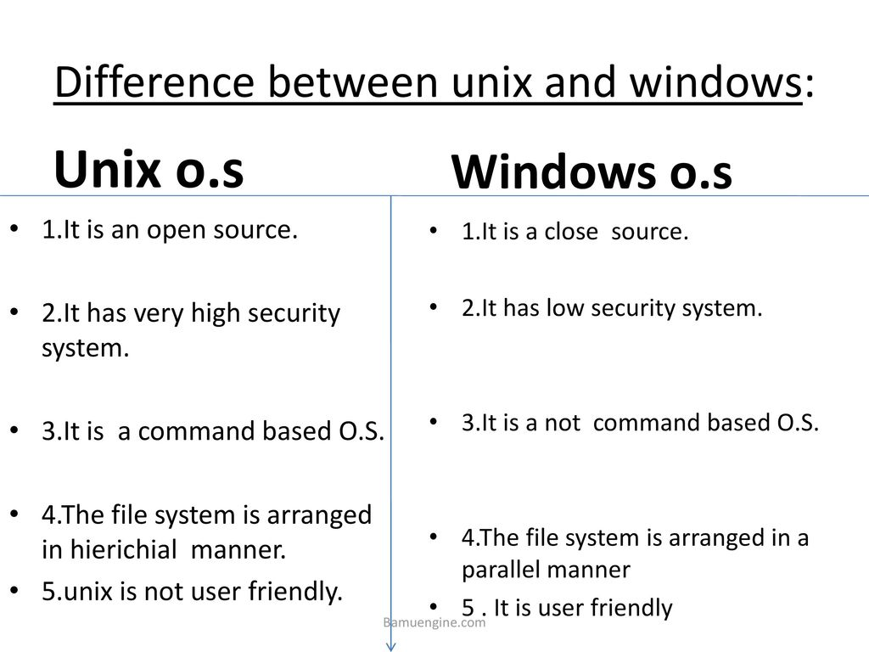

Slide 16
THE UNIX OPERATING SYSTEM
Like DOS and Windows, UNIX is another operating system.
It arrived earlier than the other two, and stayed back late enough to give us the Internet.
It has practically everything an operating system should have, and several features which other OS never had.
It runs practically on every Hardware and provided inspiration to the Open Source movement.
You interact with a UNIX system through a command interpreter called the shell.
A command may already exist on the system or it could be one written by user.

Slide 17
THE UNIX COMPONENT ARCHITECTURE
The entire UNIX system is supported by a handful of essentially simple and abstract concepts.
The success of UNIX, according to Thompson and Ritchie, “lies not so much in new inventions but rather in the full exploitation of a carefully selected fertile ideas, and especially in showing that they can be keys to the implementation of a small and yet powerful operating system”.
UNIX is no longer a small system, but it certainly is a powerful one.

Slide 18
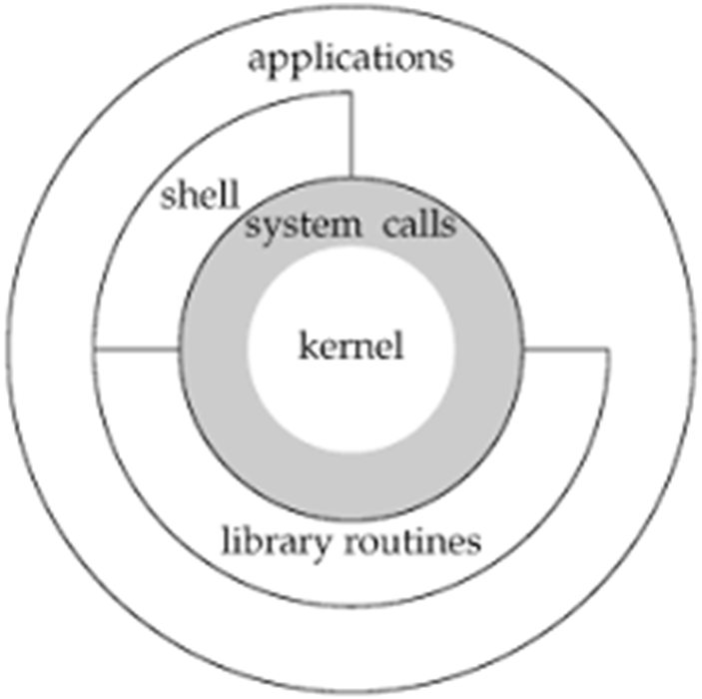
Division of labor: Kernel and shell
The UNIX architecture has three important agencies-
Division of labor: Kernel and shell
The file and process
The system calls
The fertile ideas in the development of UNIX has two agencies – kernel and shell.
The kernel interacts with the machine's hardware.
The shell interacts with the user.

Slide 19
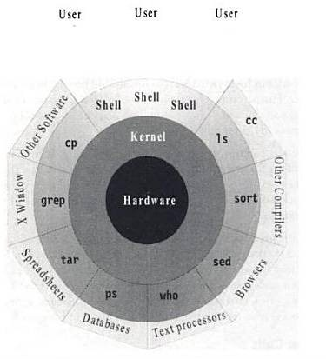
Kernel Shell Relationship

Slide 20
The Kernel
The core of the operating system - a collection of routines mostly written in C.
It is loaded into memory when the system is booted and communicates directly with the hardware.
User programs (the applications) that need to access the hardware use the services of the kernel, which performs the job on the user's behalf.
These programs access the kernel through a set of functions called system calls.
Apart from providing support to user's program, kernel also does important housekeeping.
It manages the system's memory, schedules processes, decides their priorities and so on.
The kernel has to do a lot of this work even if no user program is running.
The kernel is also called as the operating system - a programs gateway to the computer's resources.

Slide 21
The Shell
Computers don't have any capability of translating commands into action.
That requires a command interpreter, also called as the shell.
Shell is actually interface between the user and the kernel.
Most of the time, there's only one kernel running on the system, there could be several shells running – one for each user logged in.
The shell accepts commands from user, if require rebuilds a user command, and finally communicates with the kernel to see that the command is executed.
Example:
$ echo VTU Belagavi #Shell rebuilds echo command by removing multiple spaces
VTU Belagavi

Slide 22
The file and process
Two simple entities support the UNIX – the file and the process.
“Files have places and processes have life”
The File
A file is just an array of bytes and can contain virtually anything.
Every file in UNIX is part of the one file structure provided by UNIX.
UNIX considers directories and devices as members of the file system.
The Process
The process is the name given to the file when it is executed as a program (Process is program under execution).
We can say process is an “time image” of an executable file.
We also treat process as a living organism which have parents, children and are born and die.

Slide 23
The System Calls
The UNIX system-comprising the kernel, shell and applications written in C.
There are several commands that use functions called system calls to communicate with the kernel.
All UNIX flavors have one thing in common – they use the same system calls.

Slide 24
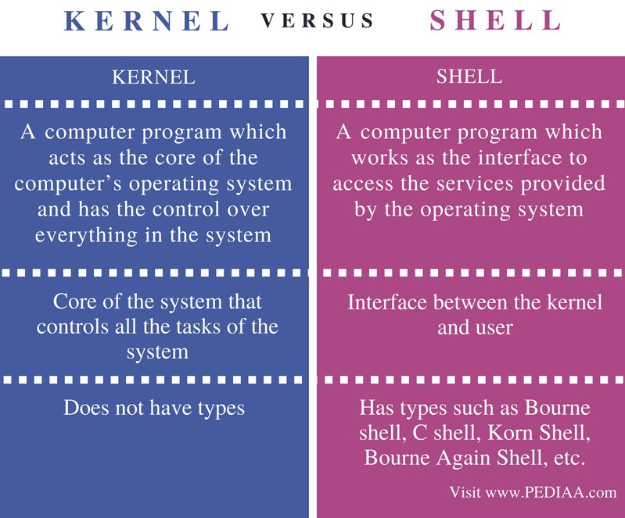

Slide 25
FEATURES OF UNIX
A Multi user
A Multitasking System
The building-block approach
The UNIX toolkit - Security & Utilities
Pattern Matching
Programming Facility
Documentation
Portability
Organized file system
Device Independence

Slide 26
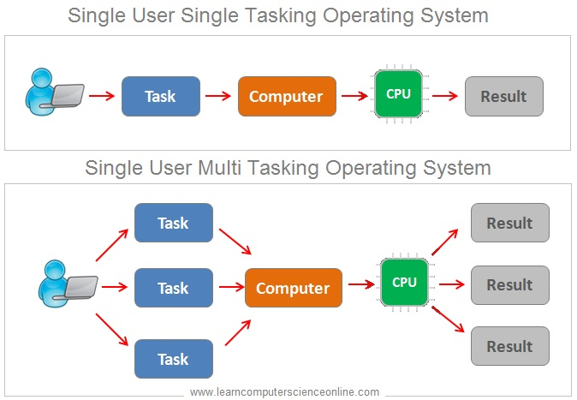
A Multiuser System
UNIX is a multiprogramming system, it permits multiple programs to run and compete for the attention of the CPU.
This can happen in two ways:
Multiple users can run separate jobs
A single user can also run multiple jobs
Single User- Windows is single user system, where system resources like CPU, Memory, I/O are all dedicated to single user.

Slide 27
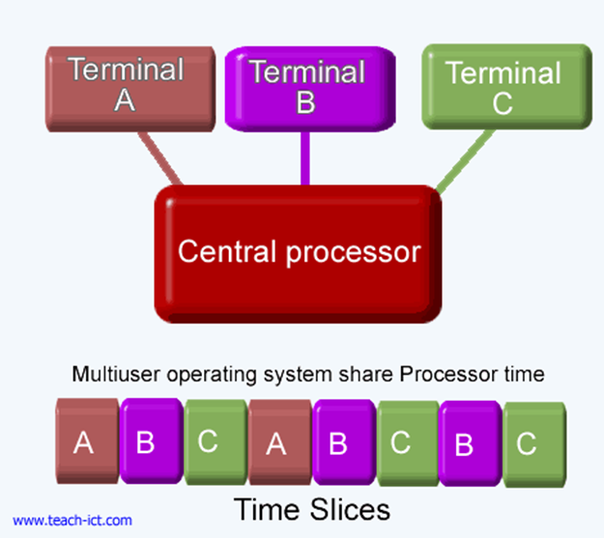
Multiple users can run separate jobs
Computer breaks the unit of time into several segments and each user is allotted a segment.
Each user is allotted the CPU in round robin fashion.
Computer does this several times in a second and keeps users ignorant and happy

Slide 28

2. A Multitasking System
A single user can also run multiple tasks concurrently.
It is usual for a user to edit a file, print another one on the printer, send email to a friend and browse www - all without leaving any of applications.
The kernel is designed to handle a user's multiple needs.
In a multitasking environment, a user sees one job running in the foreground; the rest run in the background.
User can switch jobs between background and foreground, suspend, or even terminate them.

Slide 29
3. The Building-block Approach
The designer never attempted to pack too many features into a few tools.
Instead, they felt “small is beautiful”, and developed a few hundred commands each of which performed one simple job.
UNIX offers the | (filters) to combine various simple tools to carry out complex jobs and manipulate data in different ways.
It is beacause of filters that UNIX implements “small is beautiful” philosophy
Example:
$ ls #displays the contents directory
bin
dotfiles
file.txt
irc
src
code
Downloads
go
logs
$ ls| wc #wc counts number of file in directory
9 9 43

Slide 30
4. The UNIX Toolkit
Kernel itself doesn't do much useful task for users.
UNIX offers facility to add and remove many applications as and when required.
Tools include general purpose tools, text manipulation tools, compilers, interpreters, networked applications and system administration tools.
With every new release of UNIX, new tools are added and old tools are removed/modified.
POSIX specification.

Slide 31
5. Pattern Matching
UNIX features very sophisticated pattern matching features.
Example: The * (zero or more occurrences of characters) is a special character called as metacharacter used by system to indicate that it can match a number of filenames.

Slide 32
6. Programming Facility
The UNIX shell is also a programming language; it was designed for programmer, not for end user.
It has all the necessary ingredients, like control structures, loops and variables, that establish powerful programming language.
This features are used to design shell scripts – programs that can also invoke UNIX commands.
Many of the system's functions can be controlled and automated by using these shell scripts

Slide 33
7. Documentation
The principal on-line help facility available is the man command, which remains the most important references for commands and their configuration files.
Apart from the man documentation, there's a vast ocean of UNIX resources available on the Internet.

Slide 34
8. Portability
UNIX can be installed on many hardware platforms. Its widespread use can be traced to the decision to develop it using the C language.
9. Organized File System
UNIX has a very organized file and directory system that allows users to organize and maintain files.
10. Device Independence
UNIX treats input/output devices like ordinary files. The source or destination for file input and output is easily controlled through a UNIX design feature called redirection.

Slide 35
Unix Environment
Different Computing Environments
1. Stand alone Personal Environment
2. Time sharing Environment
3.Client/server system
Personal environment
With availability of Linux, a free Unix system personal unix system trend is accelerated

Slide 36
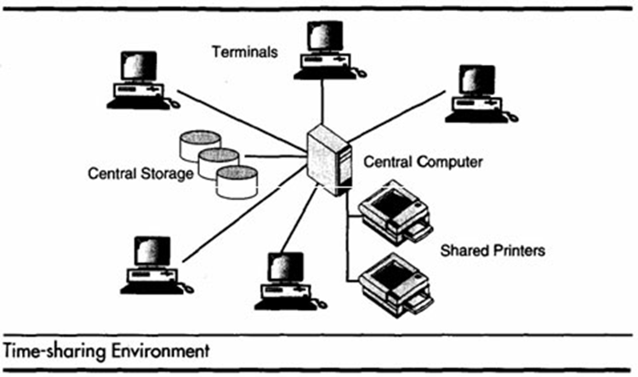
Time sharing environment

Slide 37
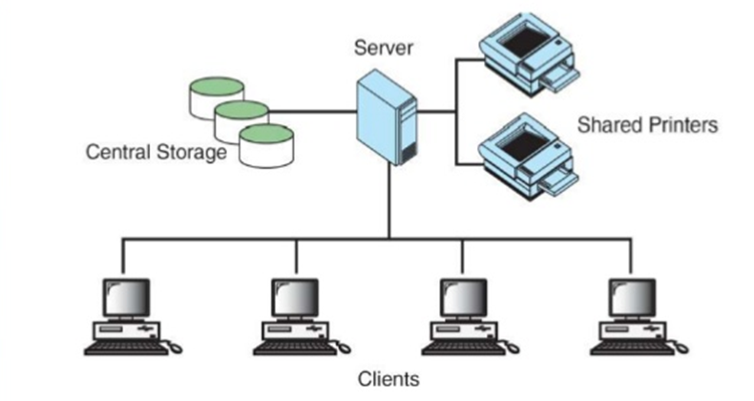
Client/Server Environment
The computing function is split between a central computer(powerful mainframe) and users computers(Micro computers). Users use personal computers/workstations. The responsibility of central computer is moved from central computer and it is assigned to personal computers.

Slide 38
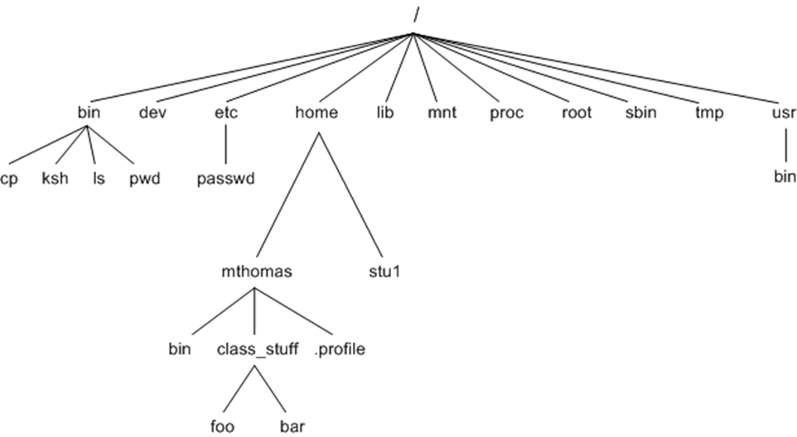
UNIX File Structure

Slide 39
POSIX AND THE SINGLE UNIX SPECIFICATION
Dennis Ritchie's decision to rewrite UNIX in C didn't make UNIX portable.
UNIX absence of single standard affected the development of portable applications.
First, AT&T creates the System V Interface Definition (SVID).
Later, X/Open – a consortium of vendors and users, created the X/Open Portability Guide (XPG).
Products of this specification were UNIX95, UNIX98 and UNIX03.
The POSIX (Portable Operating System for Computer Environment) were developed by IEEE (Institute of Electrical and Electronics Engineers).

Slide 40
Two of the most important standards from POSIX are:
POSIX.1 – Specifies the C application program interface – the system calls (Kernel).
POSIX.2 – Deals with the Shell and utilities.
In 2001, a joint initiative of X/Open and IEEE resulted in the unification of two standards.
This is the Single UNIX Specification, Version 3 (SUSV3).
The “Write once, adopt everywhere” approach to this development means that once software has been developed on any POSIX machine it can be easily ported to another POSIX compliant machine with minimum or no modification.

Slide 41
Command Structure
UNIX commands take the following general form:
verb [options] [arguments]
where verb is the command name that can take a set of optional options and one or more optional arguments.
Commands, options and arguments have to be separated by spaces or tabs to enable the shell to interpret them as words. A contiguous string of spaces and tabs together is called a whitespace. The shell compresses multiple occurrences of whitespace into a single whitespace.
Unix arguments range from simple to complex. They consists of options, expressions, instructions, file names etc.
Options
An option is preceded by a minus sign (-) to distinguish it from filenames.
Example: $ ls –l

Slide 42
There must not be any whitespaces between – and l. Options are also arguments, but given a special name because they are predetermined. Options can be normally combined with only one – sign. i.e., instead of using
$ ls –l –a –t
we can as well use,
$ ls –lat

Slide 43
Command/ Filename Arguments
Many UNIX commands use a filename as argument so that the command can take input from the file. If a command uses a filename as argument, it will usually be the last argument, after all options.
Example: cp file1 file2
rm file1 file2 file3
The command with its options and arguments is known as the command line, which is considered as complete after [Enter] key is pressed, so that the entire line is fed to the shell as its input for interpretation and execution.

Slide 44
Exceptions
Some commands in UNIX like pwd do not take any options and arguments.
Some commands like who may or may not be specified with arguments.
The ls command can run without arguments (ls), with only options (ls –l),

Slide 45
LOCATING COMMANDS
The UNIX is command based system i.e.,- things happens because the user enters commands in.
UNIX commands are seldom more than four characters long.
All UNIX commands are single words like – cat, ls, pwd, date, mkdir, rmdir, cd, grep etc.
The command names are all in lowercase.
Example:
$ LS bash: LS: command not found
All UNIX commands are files containing programs, mainly written in C.
All UNIX commands(files) are stored in directories(folders).
If you want to know the location of executable program (or command), use type command-
Example:
$ type date date is /bin/date
When you execute date command, the shell locates this file in the /bin directory and makes arrangements to execute it.

Slide 46
The PATH
The sequence of directories that the shell searches to look for a command is specified in its own PATH variable.
Example:
$ echo $PATH /bin: /usr/bin: /usr/local/bin: /usr/ccs/bin: /usr/local/java/bin:

Slide 47
Basic Commands (echo, printf, ls, who, date, passwd, cal)
echo command:(Displaying a message)
It is an internal command – when you type echo shell won’t look in its PATH to locate it. It will execute it from its own set of built in. It can be checked as follows
$type echo
echo is a shell builtin
This message is often used in shell scripts to display diagnostic message on the terminal or to issue prompts for taking user inputs
Ex: 1.
$echo hello
hello
Ex 2.
$echo “Enter filename: ”:
Enter filename:

Slide 48
Escape sequence
An escape sequence is generally a two character string beginning with a \(backslash)
Bash interpret the escape sequence only when echo is used with the –e option
Escape sequences
\a Bell
\b backspace
\c no new line
\n newline
\r carriage return
\t tab
\v vertical tab
\\ backslash

Slide 49
printf command
An alternate to echo
It exists as an external command but only in bash shell it is built in
$printf “ Good Morning\n”
Good Morning
$_
It also accepts escape sequence and formatted strings
$printf“ My Shell is %s\n” $SHELL
My Shell is /usr/bin/bash

Slide 50
printf command Cont…
Formats
%s string
%30s print in a space 30 characters
%d decimal integer
%6d print in a space 6 characters
%o octal integer
%x hexadecimal integer
%f floating point number
Ex.
$ printf “the value of 255 is %o in octal and %x in hexadecimal \n” 255 255
the value of 255 is 377 in octal and FF in hexadecimal

Slide 51
ls command
ls options
-a Lists all files, including those beginning with a dot (.).
-d Lists only names of directories, not the files in the directory
-F Indicates type of entry with a trailing symbol: executables with *, directories with / and symbolic links with @
-R Recursive list
- r sorts filesname in reverse order
-u Sorts filenames by last access time
-t Sorts filenames by last modification time
-i Displays inode number
-l Long listing: lists the mode, link information, owner, size, last modification (time).
-x output in multiple columns

Slide 52
who command
Display who are the users?
Unix maintains an account of all users who are logged on to the system and displays an informative listing of their users
$ who
root console aug 1 07:51 (:0)
kumarpts/10 aug 1 07:56 (pc123.heavens.com)
Sharmapts/6 aug 1 02:10 (pc123.heavens.com)
User name or userid’s
Device name of their respective terminals
Logging time
Machine name from where the user logged in
Who

Slide 53
date command: Displaying the system date
The unix system maintains an internal clock. When the system is shut down, a battery backup keeps the clock ticking
You can display the current date with the date command
$date
Tue Aug 16 10:30:40 IST 2016
$date +%m
08
$date +%h
Aug
$date +”%h%m”
Aug 08
Options
d - day of the month
y - last two digit of the year
H, M, S - hour, min and sec
D- date in mm/dd/yy format
T- time in format hh:mm:ss

Slide 54
passwd command- changing your password
$passwd
passwd: changing password for kumar
Enter login password:********
New password:*******
Re-enter New passowrd:*******
passwd(SYSTEM): Password successfully
changed for kumar
Encryption is stored in a file named shadow in the /etc directory

Slide 55
cal command – The calendar
cal can be used to see the calendar of any specific month or a complete year
Syntax
cal [ [ month ] year ]
Everything in rectangular bracket are optional
cal can be used without arguments
Ex 1.
$ cal
Aug 2016
month…
Ex 2.
$ cal 03 2016
Ctrl-s to make it pause

Slide 56
Combining Commands
Instead of executing commands on separate lines, where each command is processed and executed before the next could be entered, UNIX allows you to specify more than one command in the single command line. Each command has to be separated from the other by a ; (semicolon).
wc sample.txt ; ls –l sample.txt
You can even group several commands together so that their combined output is redirected to a file.
(wc sample.txt ; ls –l sample.txt) >newfile
When a command line contains a semicolon, the shell understands that the command on each side of it needs to be processed separately. Here ; is known as a metacharacter.

Slide 57
Root login
The system administrator is also known as superuser or root user.
The job of system administration involves the management of the entire system- ranging from maintaining user accounts, security and managing disk space to performing backups.
The unix system provides a special login name for the exclusive use of the administrator; it is called root.
This account doesn’t need to be separately created but comes with every system.
Its password is generally set at the time of installation of the system and has to be used on logging in:
login: root
Password: ********* [Enter]
# -
The prompt of root is #.

Slide 58
Once you login as a root you are placed in root’s home directory.
Depending on the system, this directory could be / or /root.
Administrative commands are resident in /sbin and /usr/sbin in modern systems and in older system it resides in /etc.
Roots PATH list includes detailed path , for example: /sbin:/bin:/usr/sbin:/usr/bin:/usr/dt/bin
Becoming the super user,
su command. :
su: Acquiring superuser status, Any user can acquire superuser status with the su command if they know the root password.
For example, the user abc becomes a superuser in this way.
$ su
Password: ***********
#pwd /home/abc
Though the current directory doesn’t change,
the # prompt indicates that abc now has powers of a superuser.

Slide 59
INTERNAL AND EXTERNAL COMMANDS
Internal Commands:
The shell execute command(file) from its own set of built-in commands.
Not stored as separate files in /bin directory.
$ type echo #Output as: echo is shell built-in
Execution speed is faster
Internal commands will have top priority compare
External Commands:
The command (file) has an independent existence in the /bin directory.
$ type ls # ls is an external command ls is /bin/ls
External commands less priority compare to internal command
Execution speed is slow compared to internal commands.

Slide 60
Shell starts running from the time user logs in and dies when user logs out.
Shell is an external command with a set of bulit-in commands.
So, if the command exists both as an internal and external one, shell execute internal command only.
Ex: echo is internal and external command.

Slide 61
MODULE – 1 Part 2
Syllabus :
Unix files: Naming files. Basic file types/categories. Organization of files. Hidden files. Standard directories. Parent child relationship. The home directory and the HOME variable. Reaching required files- the PATH variable, manipulating the PATH, Relative and absolute pathnames. Directory commands – pwd, cd, mkdir, rmdir commands. The dot (.) and double dots (..) notations to represent present and parent directories and their usage in relative path names. File related commands – cat, mv, rm, cp, wc and od commands.

Slide 62
UNIX Files
Naming Files
In UNIX system, a filename can consist of up to 255 characters.
Files may or may not have extensions and can consist of practically any ASCII character except the / and the Null character.
User is permitted to use control characters or other nonprintable characters in a filename. - avoid using these characters
It is recommended that only the following characters be used in filenames:
Alphabets and numerals, The period (.), hyphen (-) and underscore (_).
UNIX imposes no restrictions on the extension. In all cases, it is the application that imposes that restriction. Eg. A C Compiler expects C program filenames to end with .c,
A filename can also begin with or end with a dot.
UNIX is case sensitive; chap01, Chap01 and CHAP01 are three different filenames that can coexist in the same directory.

Slide 63
Basic File types / Categories
Ordinary File
Directory File
Device File

Slide 64
Ordinary (Regular) File
This is the most common or regular file type. It contains as stream of characters. An ordinary file can be either a text file or a binary file.
A text file –
Contains printable characters, User can view and edit them.
All C and Java program sources, shell scripts are text files.
Every line of a text file is terminated with the newline character [Enter Key].
A binary file-
Contains both printable and nonprintable characters that cover the entire ASCII range.
UNIX commands are binary files. Picture, video, object codes are binary files.

Slide 65
Directory File
Directory file contains no data, but keeps details of the files and subdirectories that it contains.
Contains one entry for every file and subdirectory that it houses.
Each entry has two components namely, the filename and a unique identification number of the file or directory (called the inode number).
When user creates or removes a file, the kernel automatically updates its corresponding directory by adding or removing the entry (filename and inode number) associated with the file.

Slide 66
Device File
All the operations on the devices are performed by reading or writing the file representing the device.
Advantage - devices are treated as files ; some of the commands used to access an ordinary file can be used with device files as well.
Device filenames are found in a single directory structure, /dev.
A device file is not really a stream of characters. It is the attributes of the file that entirely govern the operation of the device.
The kernel identifies a device from its attributes and uses them to operate the device.

Slide 67
Organization of files

Slide 68
Standard Directories
The following system files (i.e. directories) are present in most Unix file systems:
/ (root directory) - contains the directories needed at top level of File system
/bin - short for binaries, this is the directory where many commonly used
executable commands reside
/dev - contains device specific files i.e. device drivers, peripheral h/w devices
/etc - contains system configuration files
/home - contains user directories and files; Home directories of common users
/lib - contains all library files needed for users and system
/tmp -contains temp space for use by system, cleaned during reboot.
/usr - contains programs, library and documentation (user related data)
/sbin - system binary files reside here. If there is no sbin directory on your system, these files most likely reside in etc
/var – Contains storage space for log files, mail queue, print spooler

Slide 69
Parent Child relationship
All files on a Unix system are related to one another.
That is, files also have a parent-child existence.
Thus, all files (except one) share a common parental link, the top-most file (i.e. /) being the exception is called root.
Ex. pwd is the child of bin; bin in turn is the child of / (i.e. root)
Directories are organized in tree structure called file system.
Root directory has all the subdirectories of the system under it.
For instance, bin and usr are two directories under root.
Every file, apart from root, must have a parent, and it should be possible to trace the ultimate parentage of a file or root.
In these parent-child relationships the parent is always a directory.

Slide 70
Hidden Files
Invisible file is the one in which first character is either a . (dot/period Character)
Configuration information is stored in these files by Shell
Examples
.profile – The Borne Shell (sh) initialization script
.kshrc – The k Shell (ksh) initialization script
.cshrc – The C Shell (csh) initialization script
.rhosts- Remote shell configuration files

Slide 71
Home directory & HOME Variable
When user logs in, he/she will be placed in directory called home directory (in example kumar)
Home directory is created when user login account is created.
Ex.
/home/kumar
HOME Variable
A shell variable HOME indicates home directory of current user
This variable is set for user by admin in /etc/passwd
Ex.$echo $HOME
/home/kumar
Here absolute path name is shown (starting from /) subsequent /s indicate directories

Slide 72
Reaching required Files
The system goes through the following steps in order to determine which program to execute:
1. Built in commands (such as cd and history) are executed within the shell.
2. If an absolute path name (such as /bin/ls) or a relative path name (such as ./myprog), the system executes the program from the specified directory.
3. Otherwise the PATH variable is used.

Slide 73
PATH Variable (Environmental variable)
Environmental variables are used to provide information to the programs in use.
A command runs in UNIX by executing a disk file.
When a command is specified say date, the system will locate the associated file from a list of directories specified in the PATH variable and then executes it.
The PATH variable normally includes the current directory also.
Specifies the locations in which Shell has to search for files
List of directories searched by the shell to locate a command
$echo $PATH
/bin:/bin/usr:

Slide 74
Relative and Absolute Paths
ABSOLUTE PATHNAME
Directories are arranged in a hierarchy with root (/) at the top. The position of any file within the hierarchy is described by its pathname.
Elements of a pathname are separated by a /. A pathname is absolute, if it is described in relation to root, thus absolute pathnames always begin with a /.
An absolute path is a complete path from start of actual file system from / directory.
Following are some examples of absolute filenames.
/etc/passwd
/users/kumar/progs/cprogs /
dev/rdsk/Os3
Example
date command can executed in two ways as
$date // Relative path
Thu Sep 7 10:20:29 IST 2017
$/bin/date // Absolute path
Thu Sep 7 10:20:29 IST 2017

Slide 75
RELATIVE PATHNAME
A pathname can also be relative to your current working directory. Relative pathnames never begin with /. Relative to user home directory, some pathnames might look like this –
Relative path is defined as the path related to the present working directly (pwd).
progs/cprogs
rdsk/Os3

Slide 76
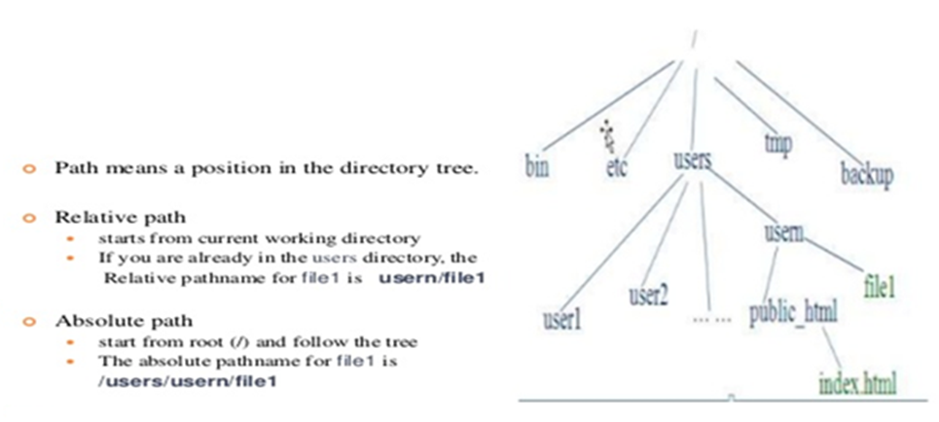
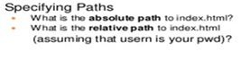
Example
Absolute path for index.html - /users/userm/index.html
Relative path to index.html - public_html/index.html

Slide 77
Directory commands – pwd, cd, mkdir, rmdir commands.
pwd: CHECKING YOUR CURRENT DIRECTORY
Any time user can know the current working directory using pwd command.
$ pwd
/home/kumar
Like HOME it displays the absolute path.

Slide 78
cd: CHANGING THE CURRENT DIRECTORY
User can move around the UNIX file system using cd (change directory) command.
When used with the argument, it changes the current directory to the directory specified as argument, progs:
$ pwd /home/kumar
$cd progs
$ pwd /home/kumar/progs
Here we are using the relative pathname of progs directory. The same can be done with the absolute pathname also.
$cd /home/kumar/progs
$ pwd /home/kumar/progs
$cd /bin $ pwd /bin
cd can also be used without arguments:
$ pwd /home/kumar/progs
$cd
$ pwd /home/kumar
cd without argument changes the working directory to home directory.
$cd /home/sharma
$ pwd /home/sharma
$cd /home/kumar

Slide 79
mkdir: MAKING DIRECTORIES
Directories are created with mkdir (make directory) command. The command is followed by names of the directories to be created. A directory patch is created under current directory like this:
$mkdir patch
You can create a number of subdirectories with one mkdir command:
$mkdir patch dba doc
For instance the following command creates a directory tree:
$mkdir progs progs/cprogs progs/javaprogs
This creates three subdirectories – progs, cprogs and javaprogs under progs.
The order of specifying arguments is important. You cannot create subdirectories before creation of parent directory.
For instance following command doesn‘t work
$mkdir progs/cprogs progs/javaprogs progs
mkdir: Failed to make directory “progs/cprogs”; No such directory
mkdir: Failed to make directory “progs/javaprogs”; No such directory
System refuses to create a directory due to fallowing reasons:
The directory is already exists.
There may be ordinary file by that name in the current directory.
User doesn‘t have permission to create directory

Slide 80
rmdir: REMOVING A DIRECTORY
The rmdir (remove directory) command removes the directories. You have to do this to remove progs:
$rmdir progs
If progs is empty directory then it will be removed form system.
rmdir expect the arguments reverse of mkdir.
Following command used with mkdir fails with rmdir
$mkdir progs progs/cprogs progs/javaprogs
rmdir: directory “progs”: Directory not empty
First subdirectories need to be removed from the system then parent.
Following command works with rmdir
$mkdir progs/cprogs progs/javaprogs progs
First it removes cprogs and javaprogs form progs directory and then it removes progs fro system.
rmdir : Things to remember
You can‘t remove a directory which is not empty, which doesn‘t exist in system, if you don‘t have permission to do so.

Slide 81
The dot (.) and double dots (..) notations to represent present and parent directories and their usage in relative path names.
Using . and .. in relative path name
User can move from working directory /home/kumar/progs/cprogs to home directory /home/kumar using cd command like
$pwd /home/kumar/progs/cprogs
$cd /home/kumar
$pwd /home/kumar
Navigation becomes easy by using common ancestor.
. (a single dot) - This represents the current directory
.. (two dots) - This represents the parent directory
Assume user is currently placed in /home/kumar/progs/cprogs
$pwd /home/kumar/progs/cprogs
$cd ..
$pwd /home/kumar/progs
This method is compact and easy when ascending the directory hierarchy. The command cd .. Translates to this ―change your current directory to parent of current directory‖.
The relative paths can also be used as:
$pwd /home/kumar/progs
$cd ../..
$pwd
/home

Slide 82
The following command copies the file prog1.java present in javaprogs, which is present is parent of current directory to current directory.
$pwd /home/kumar/progs/cprogs
$cp ../javaprogs/prog1.java .
Now prog1.java is copied to cprogs under progs directory.

Slide 83
File related commands – cat, mv, rm, cp, wc and od commands.
cat: DISPLAYING AND CREATING FILES
cat command is used to display the contents of a small file on the terminal.
$ cat cprogram.c
# include <stdio.h>
void main ()
{ printf(“hello”); }
As like other files cat accepts more than one filename as arguments
$ cat ch1 ch2
It contains the contents of chapter1 It contains the contents of chapter2 In this the contents of the second files are shown immediately after the first file without any header information. So cat concatenates two files- hence its name.

Slide 84
cat OPTIONS
Displaying Nonprinting Characters (-v)
cat without any option it will display text files. Nonprinting ASCII characters can be displayed with –v option.
Numbering Lines (-n)
-n option numbers lines. This numbering option helps programmer in debugging programs.
Using cat to create a file
cat is also useful for creating a file. Enter the command cat, followed by > character and the filename.
$ cat > new
This is a new file which contains some text, just to
Add some contents to the file new
[ctrl-d]
$_
When the command line is terminated with [Enter], the prompt vanishes. Cat now waits to take input from the user. Enter few lines; press [ctrl-d] to signify the end of input to the system To display the file contents of new use file name with cat command.
$ cat new
This is a new file which contains some text, just to
Add some contents to the file new

Slide 85
cp: COPYING A File
The cp command copies a file or a group of files. It creates an exact image of the file on the disk with a different name. The syntax takes two filename to be specified in the command line.
When both are ordinary files, first file is copied to second.
$ cp csa csb
If the destination file (csb) doesn‘t exist, it will first be created before copying takes place. If not it will simply be overwritten without any warning from the system.
Example to show two ways of copying files to the cs directory:
$ cp ch1 cs/module1 ch1 copied to module1 under cs
$ cp ch1 cs ch1 retains its name under cs
cp can also be used with the shorthand notation, .(dot), to signify the current directory as the destination. To copy a file „new‟ from /home/user1 to your current directory, use the following command:
$cp /home/user1/new new destination is a file
$cp /home/user1/new . destination is the current directory
cp command can be used to copy more than one file with a single invocation of the command. In this case the last filename must be a directory.

Slide 86
Ex: To copy the file ch1,chh2,ch3 to the module , use cp as
$ cp ch1 ch2 ch3 module
The files will have the same name in module. If the files are already resident in module, they will be overwritten. In the above diagram module directory should already exist and cp doesn‘t able create a directory.
UNIX system uses * as a shorthand for multiple filenames.
Ex: $ cp ch* usp Copies all the files beginning with ch
cp options
Interactive Copying(-i) : The –i option warns the user before overwriting the destination file, If unit 1 exists, cp prompts for response
$ cp -i ch1 unit1 $ cp: overwrite unit1 (yes/no)? Y
A Y at this prompt overwrites the file, any other response leaves it uncopied.

Slide 87
rm: DELETING FILES
The rm command deletes one or more files.
Ex: Following command deletes three files:
$ rm mod1 mod2 mod3
Can remove two chapters from usp directory without having to cd
Ex: $rm usp/marks ds/marks
To remove all file in a directory use *
$ rm *
Removes all files from that directory
rm options
Interactive Deletion (-i) : Ask the user confirmation before removing each file:
$ rm -i ch1 ch2
rm: remove ch1 (yes/no)? ? y
rm: remove ch1 (yes/no)? ? n [Enter]
A ‗y‘ removes the file (ch1) any other response like n or any other key leave the file undeleted.

Slide 88
Recursive deletion (-r or -R): It performs a recursive search for all directories and files within these subdirectories. At each stage it deletes everything it finds.
$ rm -r * Works as rmdir
It deletes all files in the current directory and all its subdirectories.
Forcing Removal (-f): rm prompts for removal if a file is write-protected. The -f option overrides this minor protection and forces removal.
$rm -rf* Deletes everything in the current directory and below

Slide 89
mv: RENAMING FILES
The mv command renames (moves) files. The main two functions are:
1. It renames a file(or directory)
2. It moves a group of files to different directory
It doesn't create a copy of the file; it merely renames it. No additional space is consumed on disk during renaming.
Ex: To rename the file csb as csa we can use the following command
$ mv csb csa
If the destination file doesn‘t exist in the current directory, it will be created. Or else it will just rename the specified file in mv command.
A group of files can be moved to a directory.
Ex: Moves three files ch1,ch2,ch3 to the directory module
$ mv ch1 ch2 ch3 module

Slide 90
Can also used to rename directory
$ mv rename newname
mv replaces the filename in the existing directory entry with the new name. It doesn't create a copy of the file; it renames it
Group of files can be moved to a directory
mv chp1 chap2 chap3 unix

Slide 91
wc: COUNTING LINES,WORDS AND CHARACTERS
wc command performs Word counting including counting of lines and characters in a specified file. It takes one or more filename as arguments and displays a four columnar output.
$ wc ofile
4 20 97 ofile
Line: Any group of characters not containing a newline
Word: group of characters not containing a space, tab or newline
Character: smallest unit of information, and includes a space, tab and newline
wc offers 3 options to make a specific count. –l option counts only number of lines, - w and –c options count words and characters, respectively.
$ wc -l ofile
4 ofile
$ wc -w ofile
20 ofile
Multiple filenames, wc produces a line for each file, as well as a total count.
$ wc -c ofile file
97 ofile
15 file
112 total

Slide 92
od: DISPLAYING DATA IN OCTAL
od command displays the contents of executable files in a ASCII octal value.
$ more ofile
this file is an example for od command
^d used as an interrupt key
-b option displays this value for each character separately.
Each line displays 16 bytes of data in octal, preceded by the offset in the file of the first byte in the line.
$ od –b file
0000000 164 150 151 163 040 146 151 154 145 040 151 163 040 141 156 040 0000020 145 170 141 155 160 154 145 040 146 157 162 040 157 144 040 143 0000040 157 155 155 141 156 144 012 136 144 040 165 163 145 144 040 141 0000060 163 040 141 156 040 151 156 164 145 162 162 165 160 164 040 153 0000100 145 171

Slide 93
-c character option
Now it shows the printable characters and its corresponding ASCII octal representation
$ od –bc file
Some of the representation:
The tab character, [ctrl-i], is shown as \t and the octal vlaue 011
The bell character , [ctrl-g] is shown as 007, some system show it as \a
The form feed character,[ctrl-l], is shown as \f and 014
The LF character, [ctrl-j], is shown as \n and 012
od makes the newline character visible too.

